Slide 1

MINI PROJECT/iNTERNSHIp -3RD SEM submitted to- dr. sapna katiyar Electronics and communication department abes institute of technology Ghaziabad affiliAted to Aktu Lucknow

Slide 2

Automatic engine locking system for drunken drivers
By- Izhar QADEER (1902900310013)

Slide 3
C ntents:
Abstract
Block diagram
Power supply
Microcontroller
Alcohol detection sensor
Buzzer driver circuit
Transformer
LCD
Motors
LM324 op-amp
Advantages
Applications
Future enhancement

Slide 4
abstract:
Most of these days, we hear lot of accidents due to drunken driving. Drunken drivers will not be in stable condition and so the rash driving is the inconvenience for other road users and also question of life and death for the drunken driver and for others.
In this project, we are developing an Auto Lock System. The input for the system is from Detection Sensors either from Alcohol Breath or any other mechanism. The controller keeps looking for the output from these sensors. If there are any traces of Alcohol above the set limit, then the system will lock the Engine.

Slide 5
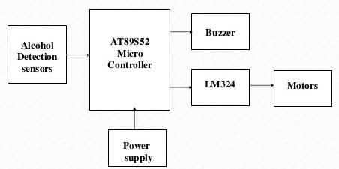
Block Diagram:

Slide 6
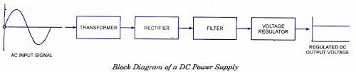
Power supply:
The above process is needed for the conversion of AC to DC using rectifiers and then ripples are removed using filter circuit(capacitor).
Here we use 7805 voltage regulator.

Slide 7
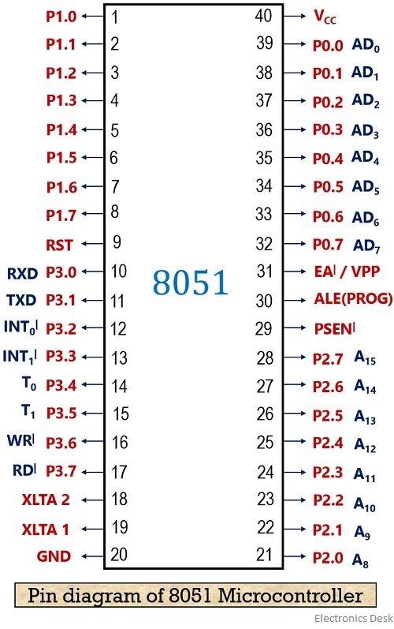
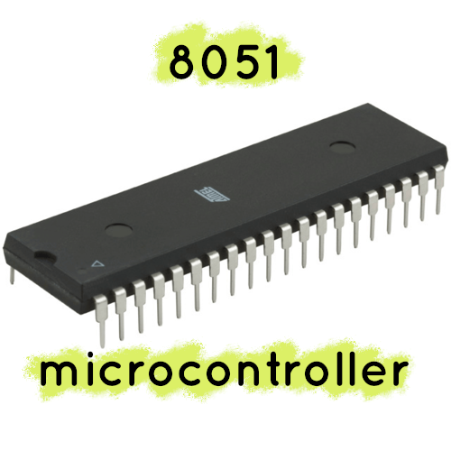
Microcontroller:

Slide 8
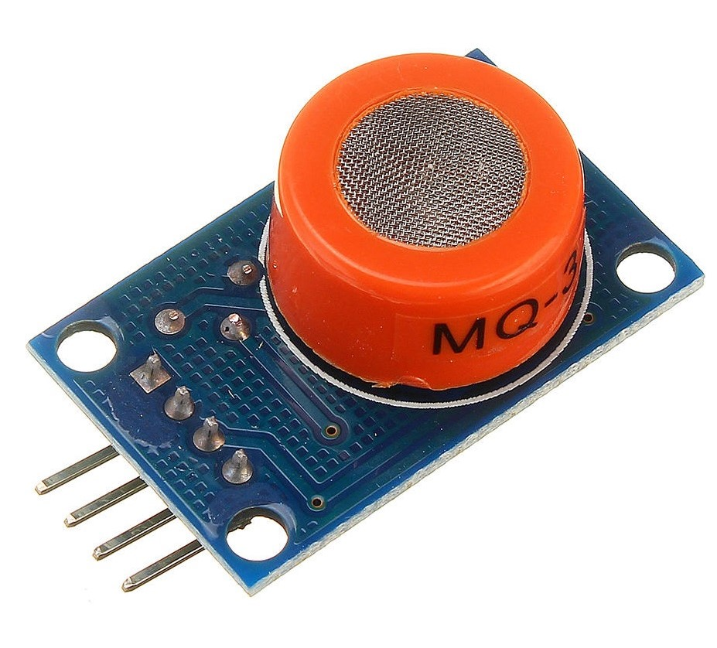
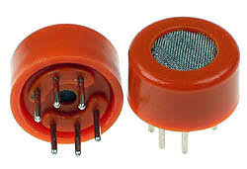
Alcohol detection sensor:
The alcohol detection sensor used in our project is MQ-3 sensor.

Slide 9
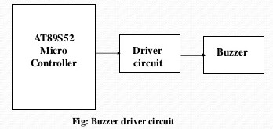
Buzzer driver circuit:
Microcontroller pins are not sufficient to drive circuits like relays and buzzers.
So we use driver circuit in between microcontroller and buzzer.
This complete structure is known as buzzer driver circuit.

Slide 10
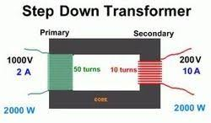
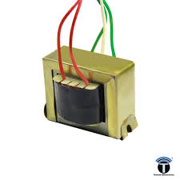
transformer:

Slide 11
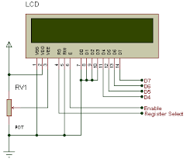
Lcd:
LCD(Liquid Crystal Display) screen is an electronic display module and find a wide range of applications. A16x2 LCD display is a very basic module and is very commonly used in various devices and circuits. A 16x2 LCD means it can display 16 characters per line and there are 2 such lines.

Slide 12
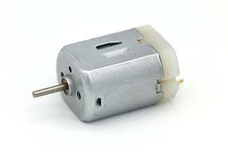
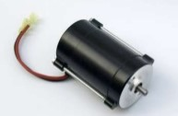
Motors:
Here we use DC motors.
The speed of a DC motor is directly proportional to the supply voltage.
If we reduce the supply voltage from 12 volts to 6 volts, the motor will run at half the speed.

Slide 13
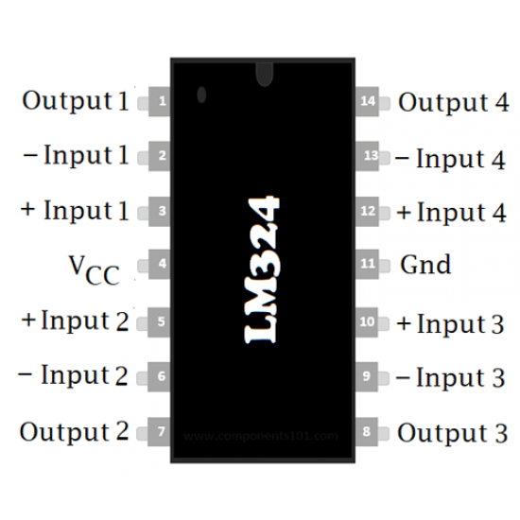
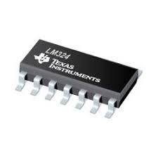
Lm324 op-amp:
The LM324 series are low-cost, quad op-amps with the true differential inputs.
They have several distinct advantages over standard operational amplifiers.
Single supply operations: 3.0V to 32V (LM224, LM324, LM324A).
Low Input Bias Currents: 100 nA Maximum (LM324A).

Slide 14
Advantages:
Low cost.
Automated operation.
Low power consumption.
It provides an automatic safety system for car and other vehicles as well.

Slide 15
Applications:
“Alcohol Detector project” can be used in various vehicles for detecting whether the driver has consumed alcohol or not.
This project can also be used in various companies or organization to detect alcohol consumption of employees.

Slide 16
Future enhancement:
We can implement GSM technology to inform the relatives or owners of the vehicle about the alcohol consumption.
We can implement GPS technology to find out the location of the vehicle.

Slide 17
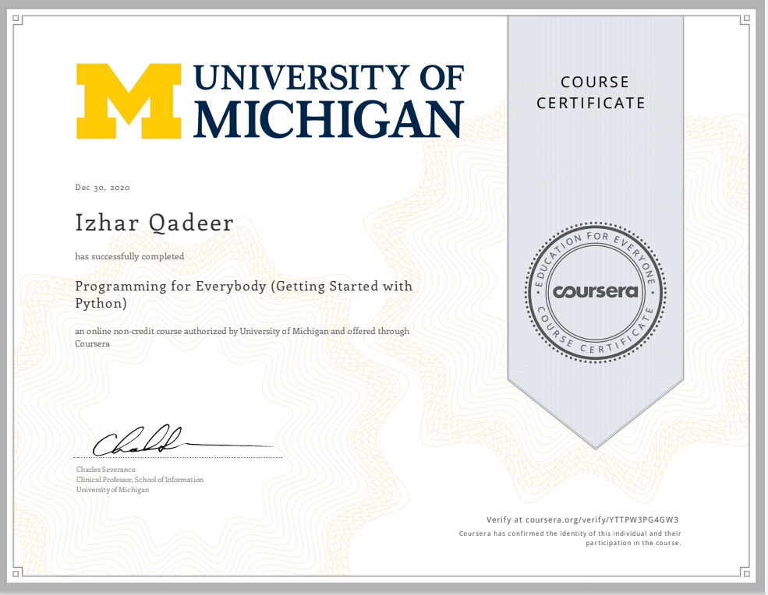

Slide 18


